Slide 1
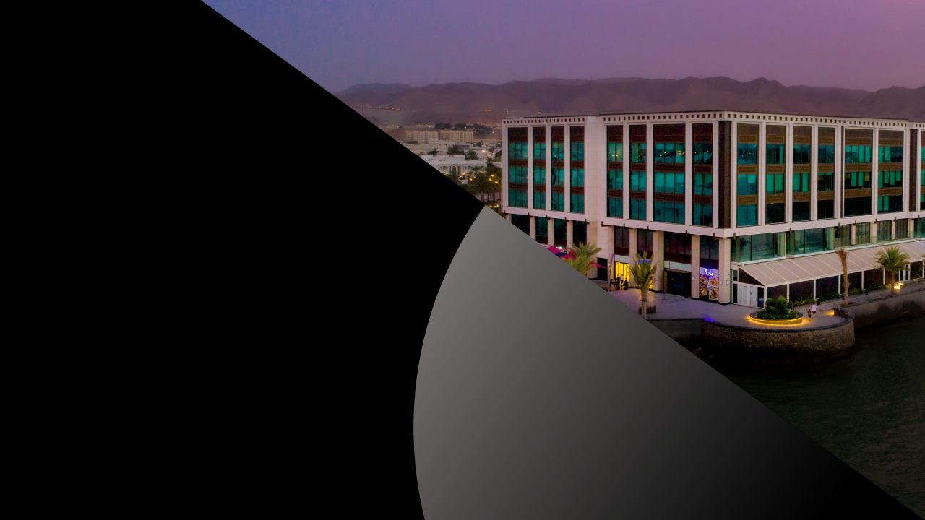

September 2022
Investor Presentation

Slide 2


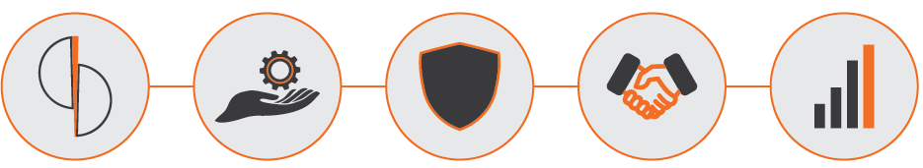
Agenda
Overview: Sohar International
Overview: Operating Environment
Overview: Governance & Risk Management Framework
Business Strategy
Financial Performance

Slide 3

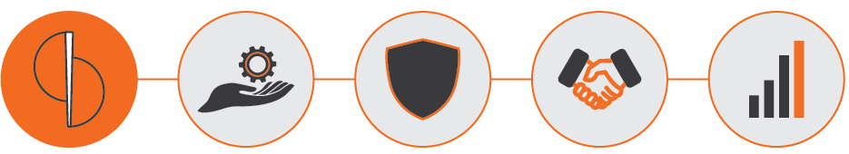
1
Overview:
Sohar International

Slide 4
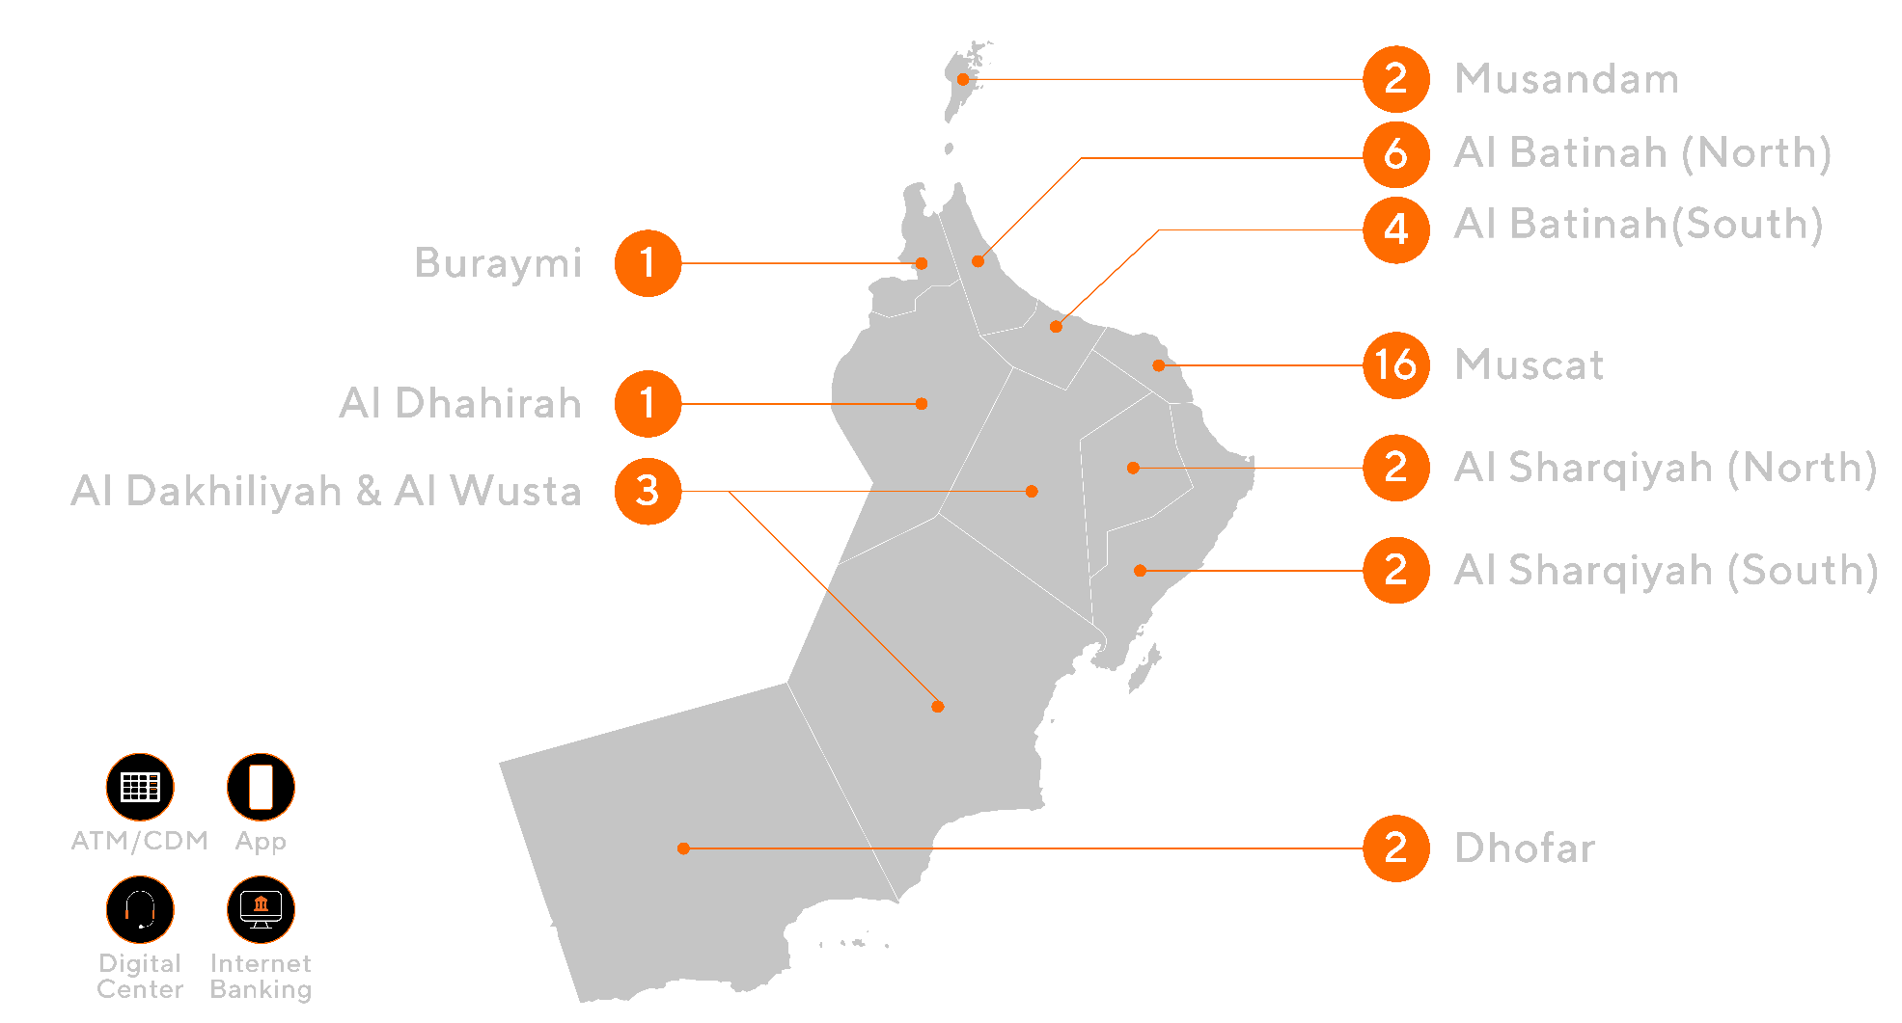
Sohar International Overview
Listed on the Muscat Stock Exchange (MSX)
Market capitalization: USD 808 Million (30 June 2022)
Established in 2007 as a public joint stock company
Sohar International Bank SAOG (formerly Bank Sohar SAOG) is primarily engaged in commercial, investment, and Islamic banking activities.
Employs 888 people as at 30 June 2022
Serves ~277,000 customers
39 branches (30 conventional & 9 Islamic) and extensive digital channels
Total assets of USD 11.3 billion as at 30 June 2022
Rated fastest growing bank in Oman with ~12% market share of assets
Operates via 3 main business segments:
  Wholesale Banking
  Retail Banking
  Islamic Banking (introduced 30 April 2013, offering a full range of Shariah Compliant products & services)
Our channels & network:
Royal Court of Affairs 16.4%
Seventh Moon Investment : 9.0%
Neptune National Investment Company : 7.8%
Western Sea Investments : 7.6%
Mars Development & Investment : 6.8%
Oman Investment Authority : 5.6%
Others: 13.8%
OIFC: 15.4%
Others 8.6%
In USD million | 2018 | 2019 | 2020 | 2021 | H1 2022
Total Assets | 7,913 | 9,104 | 9,379 | 10,738 | 11,334
Total Equity | 1,001 | 1,392 | 1,381 | 1,550 | 1,548
Net Loans | 5,849 | 6,374 | 6,503 | 6,785 | 7,095
Customer Deposits | 4,723 | 5,448 | 5,796 | 6,219 | 6,670
Operating income | 245 | 272 | 239 | 287 | 158
Net Profit | 76 | 89 | 52 | 74 | 48
Capital Adequacy % | 15.0% | 18.9% | 19.1% | 19.1% | 17.4%
ROAE % | 10.1% | 11.1% | 6.0% | 7.8% | 9.3%
Rating Agency | Date | Long-term Rating | Outlook
MOODY’S | Apr’22 | Ba3 | Stable
Fitch Ratings | Feb ’22 | B+ | Stable

Slide 5
Sohar International Key Strengths
Strong
Corporate Governance
Sound Capitalization
& Liquidity
1
8
Robust Risk Management Framework and Culture
Robust Long-Term
Growth Strategy
2
7
Strong Brand &
Corporate Franchise
Solid Growth and Resilient Financial Performance
3
6
4
5
Strong
Strategic Partnerships
Strong Ownership
Structure

Slide 6
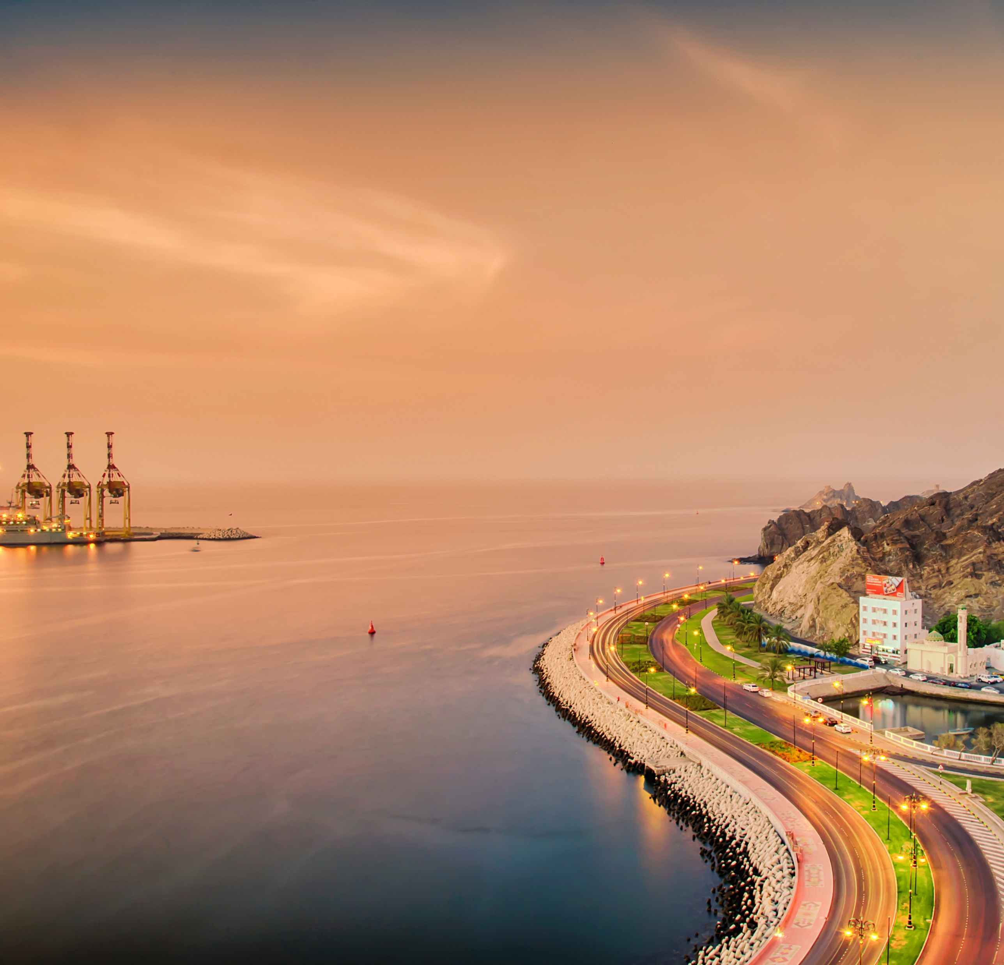
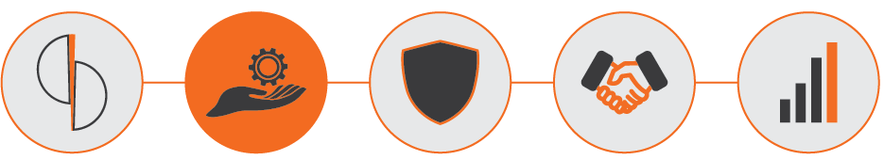
2
Overview:
Operating Environment

Slide 7
Oman Economic Overview
 | 2017 | 2018 | 2019 | 2020 | 2021 | 2022e | 2023f
Real GDP % growth | 0.3 | 0.9 | -0.8 | -2..8 | 2.0 | 5.6 | 2.7
Nominal GDP $b | 70.6 | 79.8 | 76.3 | 72.1 | 83.7 | 110.1 | 110.3
Inflation % | 1.6 | 0.9 | 0.1 | -0.9 | 1.5 | 3.7 | 2.2
Fiscal Balance % of GDP | -12 | -7.7 | -5.6 | -16.5 | -2.5 | 5.6 | 6.3
Current A/C % of GDP | -15.6 | -5.4 | -5.5 | -12.0 | -3.7 | 5.9 | 5.6
GDP growth rate of GCC economies in 2022: Kuwait (8.2%), Saudi Arabia (7.6 %), Oman (5.6%), the UAE (4.2 %), Qatar (3.4 %), and Bahrain (3.3 %).
Oman is now benefiting from higher oil prices and fiscal and governance reforms. 2022’s average crude oil prices has been about US$95 per barrel, relative to US$61 per barrel in 2021.
Oman’s projected GDP is primarily due to efforts to expand and diversify the economy, as well as encourage more investors to set up businesses in the country. The focus is on supporting local production, focusing on national industries, and opening new markets for them.
Govt. has undertaken a wide range of important reforms towards economic diversification and setting Oman on a path for sustainable economic growth.
STRONG RECOVERY:
Oman’s GDP would grow by 5.6 % in 2022,
and a further 2.7 % in 2023, and 2.5 % in 2024.
Rating Agency | Date | Rating | Outlook
S&P | Apr 2022 | BB- | Stable
MOODY’S | Oct 2021 | Ba3 | Stable
Fitch Ratings | Aug 2022 | BB | Stable
Source: National Centre for Statistics & Information, World Bank, World Bank’s Global Economic Prospects, Press

Slide 8
Oman Banking Sector Overview
The Omani banking sector comprises 20 licensed banks: 8 local listed banks (including 1 Islamic), 2 state-owned specialized banks, 9 foreign commercial banks, and 1 Islamic Bank subsidiary. Islamic windows are operated by all listed banks except for HSBC.
Central Bank of Oman (CBO) is a prudent and strong regulator, having introduced many regulations to enable a sustainable banking sector growth, as well as leading the implementation of international best practices including Basel and IFRS.
Sound capital and stable liquidity levels despite lower oil prices and COVID-Crisis
Robust domestic deposit base allows minimal dependence on overseas funding.
Islamic banking assets have 15.4 per cent market share of total banking sector assets as of the end of March 2022
Source: Central Bank of Oman Statistical Bulletin, Prospectus; Bank Financial Results (Dec-20); Conversion Rate: 1.00 OMR = 2.5974 USD.
* Calculated as 12 months average figures

Slide 9
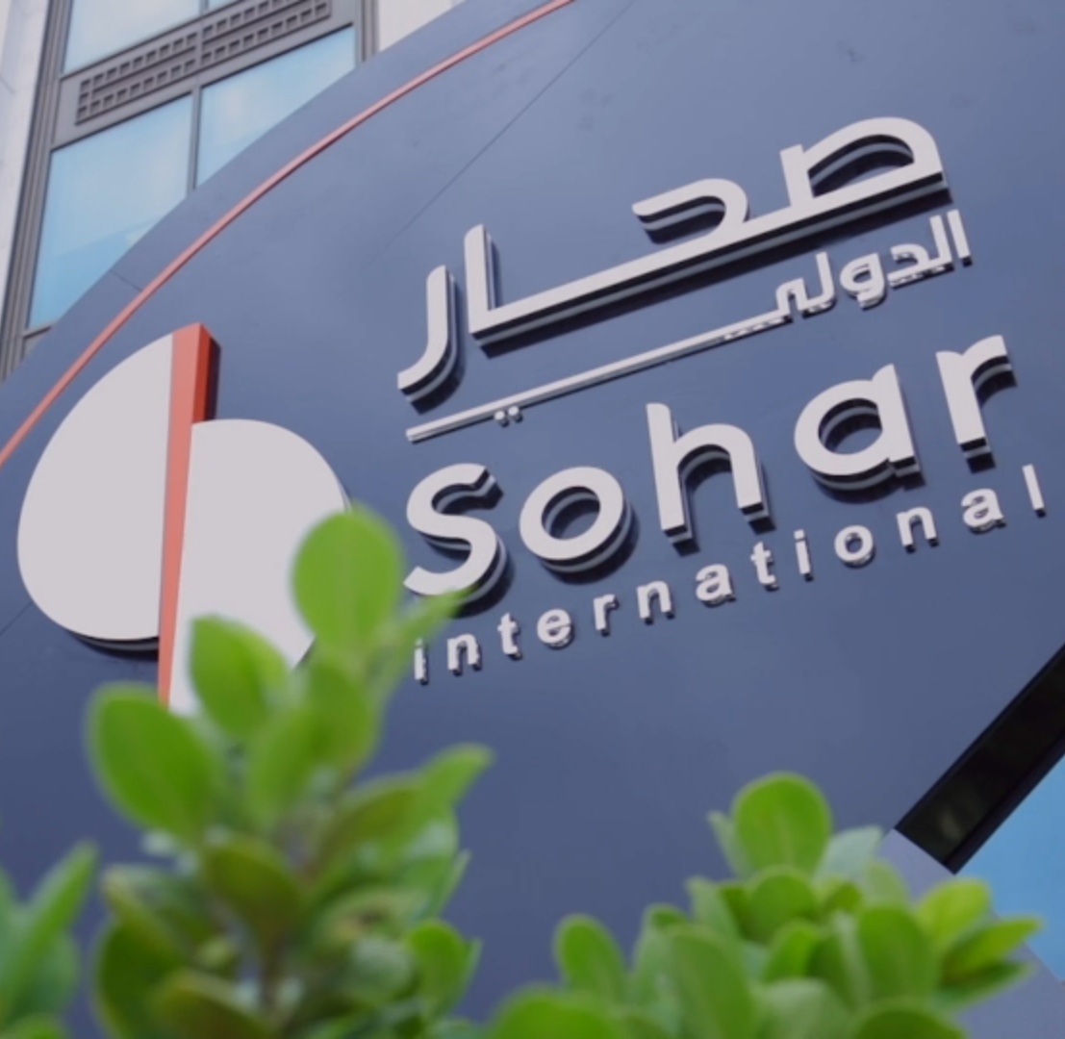
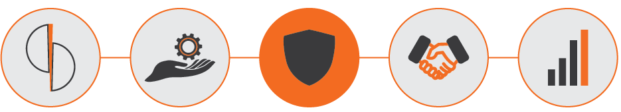
3
Overview: Governance &
Risk Management Framework

Slide 10
Robust Governance Structure &
Risk Management Framework
Board of Directors
(BOD)
Board
Audit Committee
Executive, Nomination &
Remuneration Committee
Board
Credit Approval Committee
Board
Risk Committee
Key Management Committees
Asset & Liability Committee (ALCO) | Executive Credit Committee (ECC) | Management Risk Committee (MRC) | Business Technology Committee (BTC) | Investment Committee
Asset & Liability Committee (ALCO)
Executive Credit Committee (ECC)
Business Technology Committee (BTC)

Slide 11
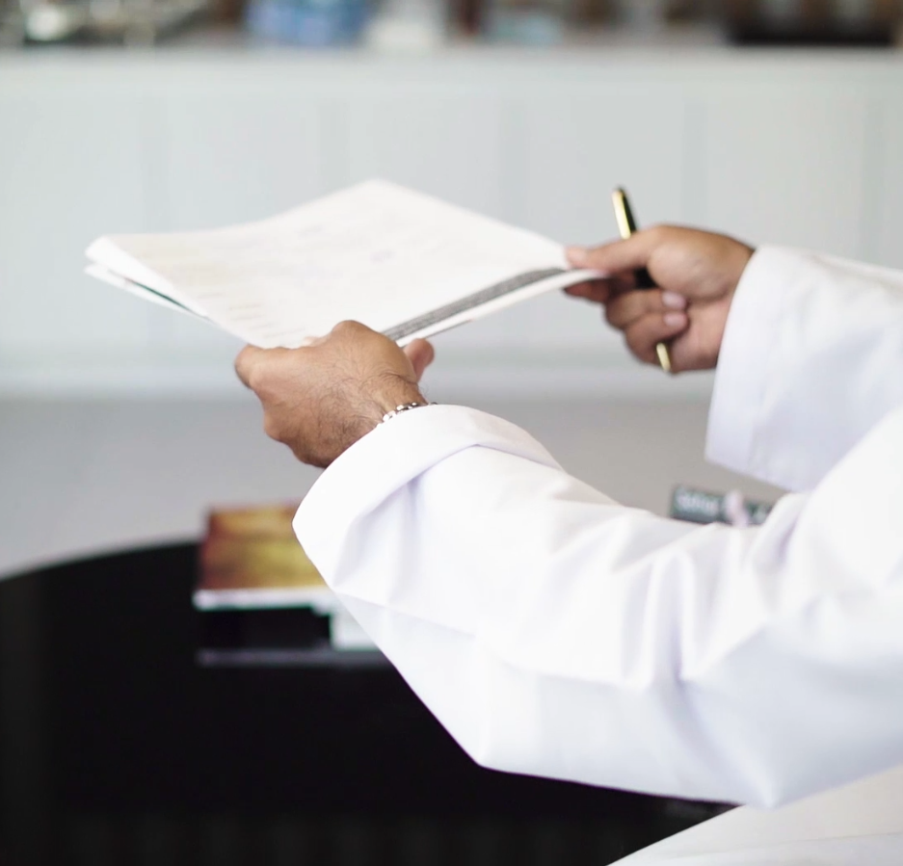
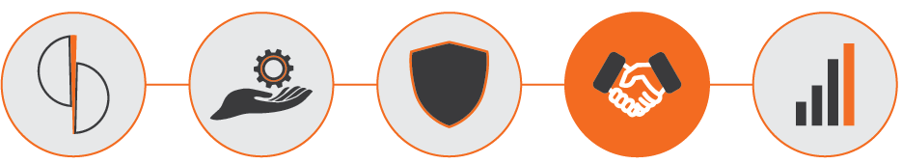
4
Business Strategy

Slide 12



Key Business Lines
Wholesale Banking | Retail Banking | Islamic Banking
Offers a wide range of financial solutions including but not limited to Project Finance, Working Capital facilities, Transaction Banking (cash management, trade solutions & supply-chain finance), Global Markets (treasury), Investment Banking (corporate finance & advisory and asset management) and digital services to Government Institutions & Agencies, Financial Institutions, Large Business Groups, Mid-Corporates and SMEs. Extensive global network of banking relationships and partnerships to provide world-class financial solutions to clients across multiple geographies at competitive rates. Customized services to meet needs of clients though a team of experienced relationship managers | Offers a wide range of products and services that include but limited to personal loans, housing loans to deposit products, credit cards, and fund transfer facilities through physical and digital touchpoints Offers value propositions across bancassurance, cards, Fx services, digital payments, and wealth management services Offers compelling Wealth Management value propositions including fiduciary advice, personalized services with highly customized financial solutions and investment products Established an exclusive strategic alliance with European Financial Group (EFG) to broaden its product ranges and services for its customers with access to global marketplaces and insights. | Offers a full range of Islamic banking services and products Accepts Shariah compliant customer deposits and provides Shariah compliant financing based on Murabaha, Mudaraba, Musharaka, Ijarah, Istisna'a, Salam Provides commercial banking services, investment and other activities permitted under Islamic Banking Regulatory Framework Offers to Corporate and SME customers Term Financing, Working Capital Financing, Short-term Financing, Corporate Deposits, Trade Finance, Cash Management Services and Treasury products. Offers an integrated set of value propositions, including digital banking to HNI customers
Total Assets (USD Bn) | Total Liabilities (USD Bn) | Net Operating Income (USD Mn)
As of 31 December 2021

Slide 13






Developed a well defined strategic path
Well-Defined Purpose
Clear Vision, Values & Strategy
Re-Wired Structure & Design
  Set Management Rhythms
  New Working environment
  Enhanced Governance
  Built Capabilities:
  People
  Systems
  Processes
Built Technology Platforms
Set Clear Digital Roadmap
Transformed Brand
Vision
To be a world-leading Omani service company, that helps customers, communities and people to prosper and grow
Pillars
Purpose
Promise
Principles
Personality
Experience
Revamp Brand
Asset Quality & Infosec
Value Proposition
CASA
Revenue Diversification
Performance Driven Culture
Talent Management
Service & Operational Excellence
Digitalization
Business Intelligence
Strategic Themes

Slide 14
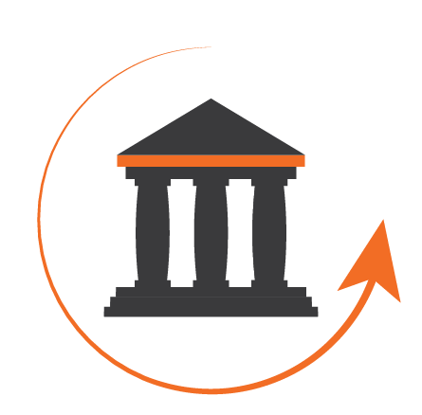
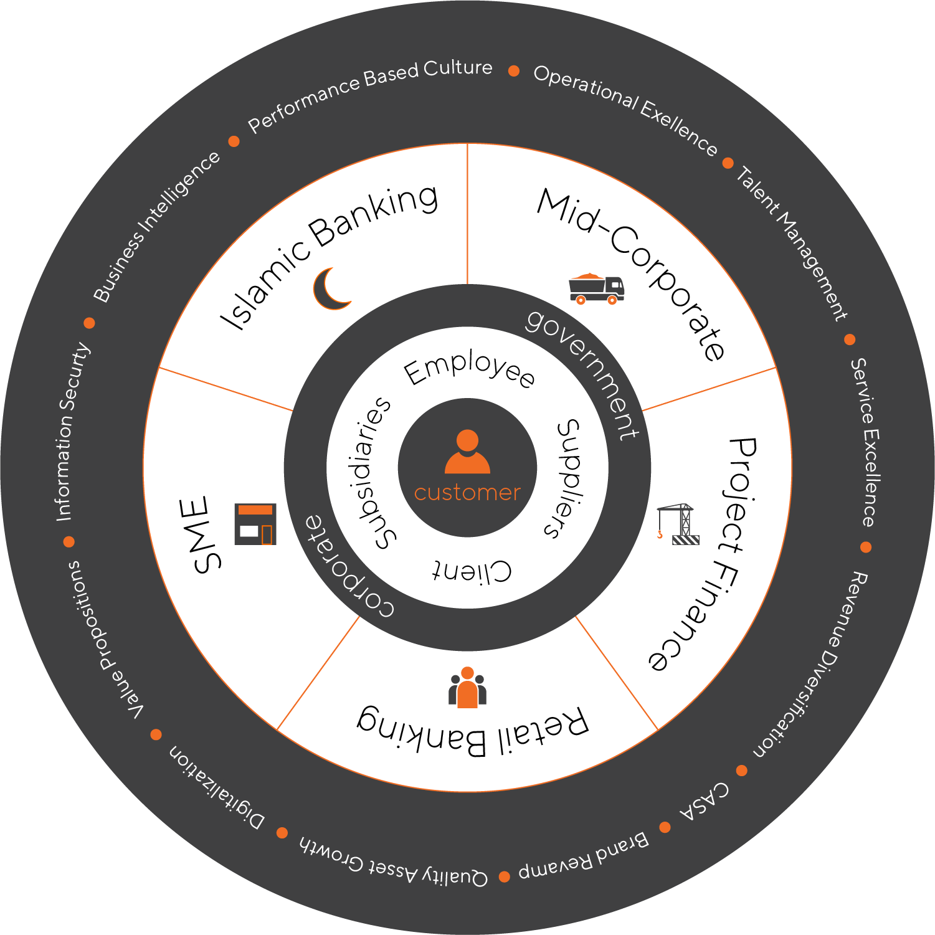

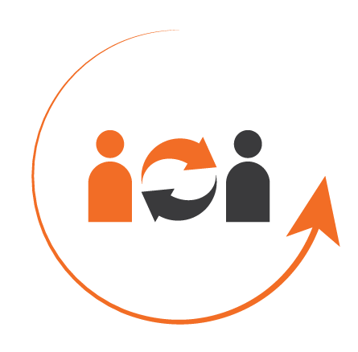

Staying Relevant & Resilient in the New Age
Re-imagine Banking
Scope – beyond banking
Ecosystem
Business Model
Re-evaluate Value Chains
BI, Analytics & Product Development
Operations Management
Distributions & networks
Re-connect with Customers
Journeys / customer experience
Engaging & communicating
Managing & leveraging relationships
Re-build the Organization
Structure & Alignment
Capabilities – People, Systems & Processes
Learning & development

Slide 15
Strategic Growth Priorities
Scaling up beyond borders Setting up branch in Saudi Arabia | Strengthening Capital Base Rights Issue of OMR 160M and Perpetual of OMR 50M (green shoe of OMR 25M) | Solidifying Domestic Presence Pursuing inorganic growth opportunities

Slide 16


Environmental, Social & Governance (ESG)
Highly committed market leader
Sohar International demonstrates its commitment to ESG through appointment of Head of ESG (the first and only bank in Oman to do so).
Highest level of accountability for ESG now established.
Management reporting lines for Head of ESG firmly established through CEO and responsible Board Committee.
Strategic focus
Support and enable the Sultanate of Oman’s 2040 Vision of economic diversification (35% of total revenue generated from non-oil sources); sustainable development through the development of socially responsible, inclusive and eco-friendly sectors
Supporting the Sultanate of Oman’s commitments to the Paris Climate Agreement and the UN’s Sustainable Development Goals
Drive Oman’s ESG agenda and create value for Sohar International’s stakeholders through development of a market leading ESG Framework, ensuring effective ESG risk management, and identifying sustainable financing solutions for customers.

Slide 17
Delivering on Promises
Implementation of the 5-year Strategy
Increased capital by OMR140 M
Delivered market leading financial results
Established a strategic alliance with EFG
Launched the first e-wallet (eFloos)
Strengthened the leadership team
Fastest Growing Commercial Bank Award
Covid Response Innovation Award
Best Corporate Bank Award
Awarded the Most Innovative Bank
Most Improved Bank in Profitability Management
Rights Issue
HCM & TB went Live
Birth of Bank Sohar
Named “Fastest Growing Bank” in Oman
Recognized as the best Financial Brand in Oman
Celebrated a decade of Banking Excellence
2009
2013
2016
2018
2020
2022
2007
2012
2015
2017
2019
2021
Achieved “break-even” profit
Launch of Sohar Islamic
Launch of Mobile Banking
Appointed new CEO
Rebranded to Sohar International
Redefined a new growth path
Delivered market leading financial performance
Weathered impacts of COVID
Differentiated our capabilities
Launch of robust digital platforms
Awarded Best Performing Bank in Oman (The Banker magazine)
Crossed USD1 Bn in AUM
Named Fastest Growing Commercial Bank & Fastest Growing Bank - Large Banks
Named Best Corporate Bank in Oman & Best Retail Banking in Oman
Created a dedicated unit & resources for ESG
PHASE 1
INCEPTION
PHASE 2
STABILIZATION
PHASE 3 TRANSFORMATION
PHASE 4
GROWTH

Slide 18
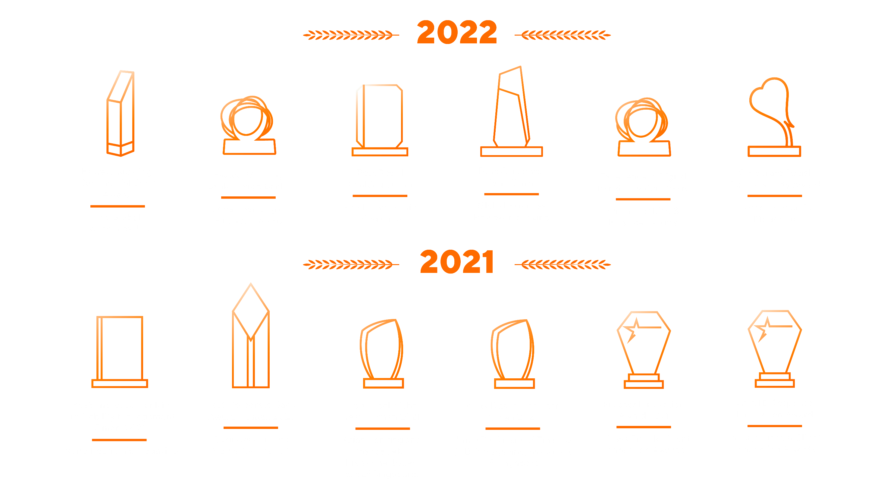

Slide 19

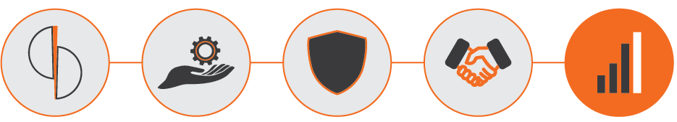
5
Financial Performance

Slide 20
Financial Highlights at a Glance (H1’22 VS H1’21)
Robust results throughout the cycle
(USD millions)
Net Profit |  | Operating Profit
48.0 | 21.5% | 89.5 | 12.5%
Loans |  | Deposits
7,095 | 8.1% | 6,670 | 11.5%
NIM |  | Cost / Income |  | ROA |  | ROE
2.44% | 24bp | 43.2% | 30bp | 0.9% | 10bp | 9.3% | 30bp

Slide 21
Earnings & Profitability
H1 2022 results reflected a strong rebound in performance following the challenges of 2020 and 2021 with operating income up by 12% and net profit by 22% versus 1H 2021.
Cost to Income ratio remains below peer group mean even though the bank continues to invest significantly in technology and people.
Asset yields were impacted as the bank responded to COVID economic impacts including delayed assets re-pricing despite increased credit risk , regulatory pricing caps on retail lending, interest waivers and interest deferments.
Customer deposits grew at a rate of 12% in H1 2022 with CASA seeing growth of 28% thereby supporting the Banks’ lower cost of funding. Short term interbank funding opportunities also supported the COF.
Net Revenue Breakdown (USD Mn)
** Other Income include investments and foreign exchange
Net Interest Margin (NIM) %
Cost to Income %

Slide 22
Earnings & Profitability

Slide 23
Asset Quality
Modest Lending growth in year 2020 & 2021 reflects response to adverse economic impact of COVID-19 , lower oil prices and focus on quality assets.
Diversified portfolio across the sectors with continued focus on improving asset quality and re-balancing sector exposures as opportunities arise.
Non-performing loans to gross loans improved since 2020 reflecting bank’s prudent approach to managing problem loans including remediation and recovery plans. Increasing NPL coverage ratio also reflects managements prudent approach.
Breakdown of Gross Loans by Sector (December 2021)

Slide 24
Funding & Liquidity
Net loans to deposits ratio continues to improve reflecting managements focus on building strong funding and liquidity platform, positioning the bank for further growth.
Focus on building a stable, low cost deposit base has seen continued improvement in the Bank’s CASA ratio; from 44% in 2018 to 63% in H1 2022.
Current holdings of high quality liquid assets and investments in the form of Oman government bonds and Treasury bills support Bank’s overall liquidity management.

Slide 25
Capitalization
Capital ratios are all above minimum regulatory requirements.
CET1 capital ratio currently stands at 11.18% and is complemented by Additional Tier 1 capital securities of OMR 200m that supports a strong total capital adequacy ratio and optimizes the overall capital structure to support growth plans.
Strong and committed shareholders.

Slide 26
Profit & Loss Summary
USD million | 2018 | 2019 | 2020 | 2021 | H1 2022
Interest income | 339 | 381 | 382 | 385 | 198
Interest expense | (192) | (199) | (195) | (183) | (85)
Net interest income | 147 | 182 | 187 | 202 | 113
Net income from Islamic financing and investing activities | 12 | 15 | 15 | 21 | 12
Net fees and commission | 41 | 50 | 33 | 42 | 26
Other income | 45 | 25 | 4 | 22 | 7
TOTAL OPERATING INCOME | 245 | 272 | 239 | 287 | 158
TOTAL OPERATING EXPENSES | (103) | (118) | (117) | (130) | (68)
NET OPERATING INCOME | 142 | 154 | 122 | 157 | 90
Loan impairment charges and other credit risk provisions (net) | (53) | (49) | (60) | (70) | (34)
PROFIT BEFORE TAX | 89 | 105 | 62 | 87 | 56
Income tax expense | (13) | (16) | (10) | (13) | (8)
PROFIT FOR THE PERIOD | 76 | 89 | 52 | 74 | 48
Conversion rate: 1.00 OMR = 2.5974 USD
Source: Sohar International's Annual and Quarterly Financial Statements

Slide 27
Balance Sheet Summary
USD million | 2018 | 2019 | 2020 | 2021 | H1 2022
ASSETS
Cash and balances with Central Bank | 188 | 233 | 526 | 249 | 291
Due from banks | 315 | 515 | 212 | 449 | 432
Loans, advances and Islamic financings, net | 5,849 | 6,374 | 6,503 | 6,785 | 7,095
Investment securities | 1,384 | 1,656 | 1,821 | 2,681 | 2,725
Property and equipment | 51 | 100 | 115 | 124 | 125
Other assets | 126 | 226 | 202 | 450 | 666
TOTAL ASSETS | 7,913 | 9,104 | 9,379 | 10,738 | 11,334
LIABILITIES
Due to banks | 1,875 | 1,910 | 1,872 | 2,387 | 2,295
Customer deposits | 4,723 | 5,448 | 5,796 | 6,219 | 6,670
Subordinated loans | 92 | 92 | 92 | 92 | 93
Other liabilities | 222 | 262 | 238 | 490 | 728
TOTAL LIABILITIES | 6,912 | 7,712 | 7,998 | 9,188 | 9,786
EQUITY
Share capital | 515 | 614 | 637 | 767 | 767
Share premium | 47 | 52 | 47 | 47 | 47
Retained earnings | 101 | 100 | 36 | 43 | 40
Other reserves | 78 | 107 | 142 | 174 | 175
Total Shareholders' Equity | 741 | 873 | 862 | 1,031 | 1,029
Perpetual Tier 1 capital securities | 260 | 519 | 519 | 519 | 519
TOTAL EQUITY | 1,001 | 1,392 | 1,381 | 1,550 | 1,548
TOTAL LIABILITIES AND EQUITY | 7,913 | 9,104 | 9,379 | 10,738 | 11,334
Conversion rate: 1.00 OMR = 2.5974 USD Source: Sohar International's Annual and Quarterly Financial Statements

Slide 28
Disclaimer
Important notice
The information, statements and opinions set out in this presentation and accompanying discussion (“this Presentation”) are for informational and reference purposes only and do not constitute a public offer for the purposes of any applicable law or an offer to sell or solicitation of any offer to purchase any securities or other financial instruments or any advice or recommendation.
This Presentation, which does not purport to be comprehensive nor render any form of legal, tax, investment, accounting, financial or other advice, has been provided by Sohar International (“the Bank”) and has not been independently verified by any person. You should consult your own advisers as to legal, tax investment, accounting, financial or other related matters concerning any investment in any securities. No responsibility, liability or obligation (whether in tort, contract or otherwise) is accepted by the Bank or their officers, employees, agents or advisers as to or in relation to this Presentation (including the accuracy, completeness or sufficiency thereof) or any other written or oral information made available or any errors contained therein or omissions therefrom, and any such liability is expressly disclaimed.
Forward looking information
The financial information and other numerical disclosures in this presentation are unaudited. The most recent Annual Report, audited annual financial statements and unaudited quarterly interim condensed financial statements are available on the Bank’s website.
This Presentation may contain forward-looking statements. Forward-looking statements are statements that are not historical facts; they include statements about our beliefs and expectations and the assumptions underlying them.
These statements are based on plans, estimates and projections as they are currently available to the management of the Bank. Forward-looking statements therefore speak only as of the date they are made, and we undertake no obligation to update publicly any of them in light of new information or future events. By their very nature, forward-looking statements involve risks and uncertainties. A number of important factors could therefore cause actual results to differ materially from those contained in any forward-looking statement. Such factors include the conditions in the financial markets in the Sultanate, the prevailing market volatility, potential defaults of borrowers or trading counterparties, the implementation of our strategic initiatives, the reliability of our risk management policies, procedures and other risks.
Non-IFRS measures
This presentation also contains non-IFRS financial detail.

Slide 29
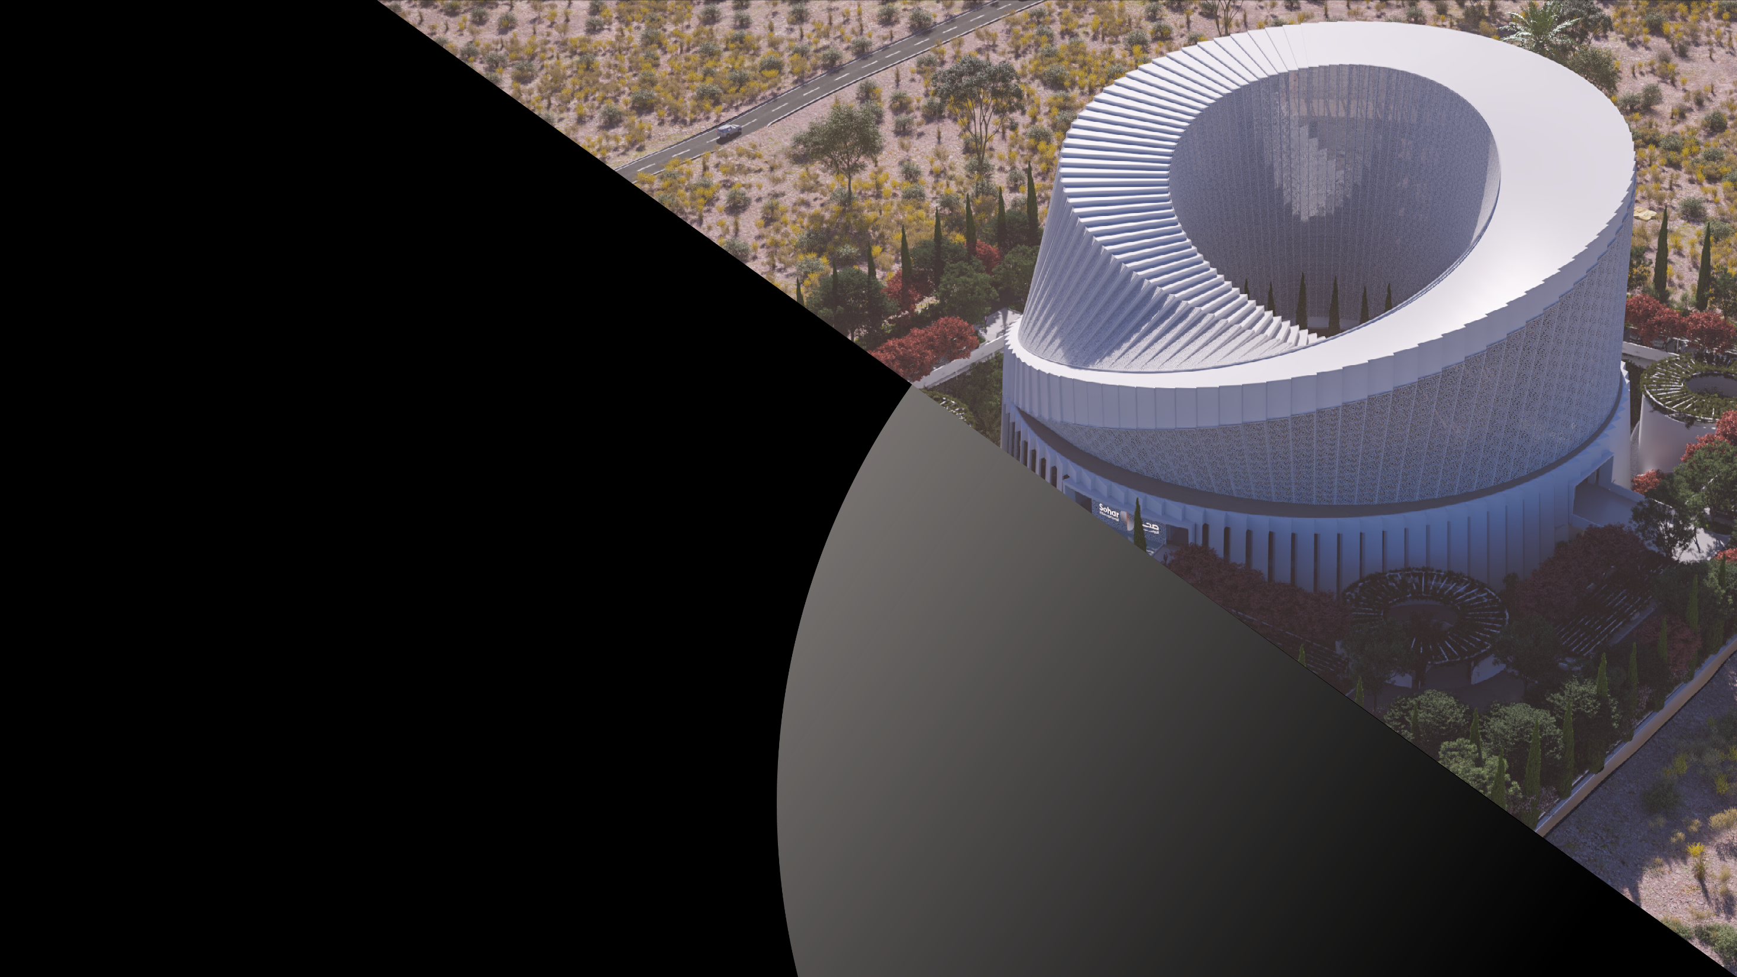
Thank You

